Slide 1
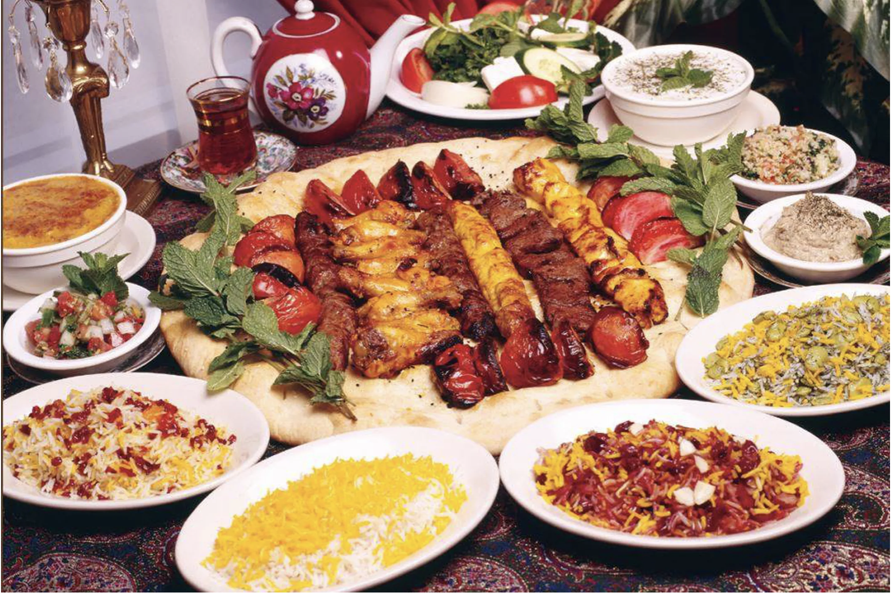
Team 7 – Yelp Restaurant Recommendation Tool
Group Members: Annie Gaver, Shreyashi Mukhopadhyay, Leticia Davordzi, Hedieh Basiri, Mohammad Khasawneh

Slide 2
Summary of Project
Group 7 set out to use the Yelp Reviews, Business Information, and User Information to design a recommendation system. Recommendations were limited to the reviews from restaurants based in Toronto, Canada.
We utilized a variety of skills taught in MSA 8050 including processing data on the cloud, RDD’s , and ML pipelines.
Also, we also got a real-life experience of the slowness of working with RDDs in comparison with a dataframe. However, we needed the RDDs’ flexibility to build the Market Basket Analysis tool.
A generous amount of data exploration was conducted through Sentiment Analysis.
Ultimately, our two Recommendation Tools were built using techniques known as Market Basket Analysis and Alternating Least Squares

Slide 3
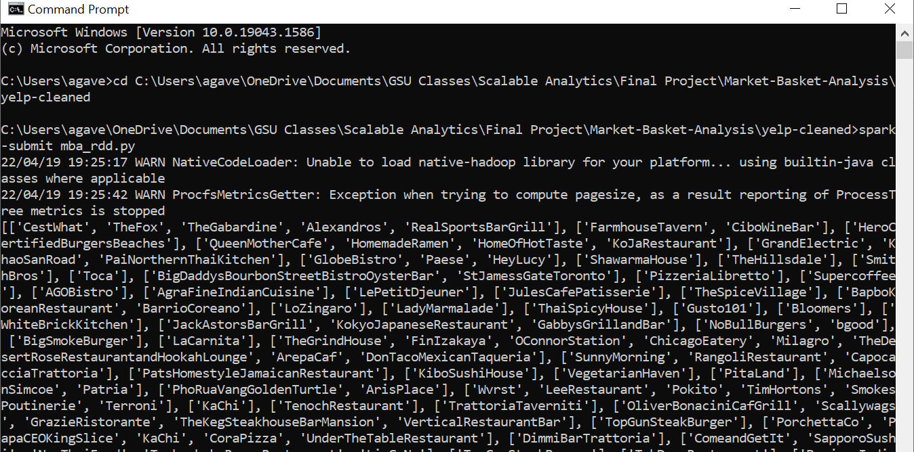
Cleaning Data on the Cloud
We chose to clean our data on the cloud because we wanted a way to utilize what we learned in class, but also return output files that everyone was able to easily access.
Main Files Used - Yelp Reviews, Users, and Business csv files. These were pushed to the Hadoop File System
Joined files and filtered by Toronto based restaurants using pyspark
Returned a cleaned RDD, which we then used for our other analyses.

Slide 4
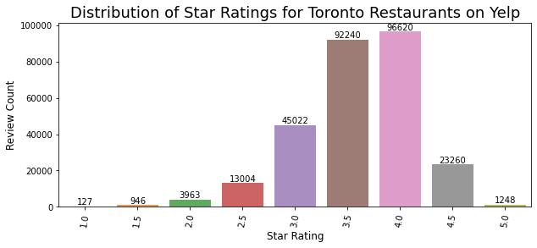
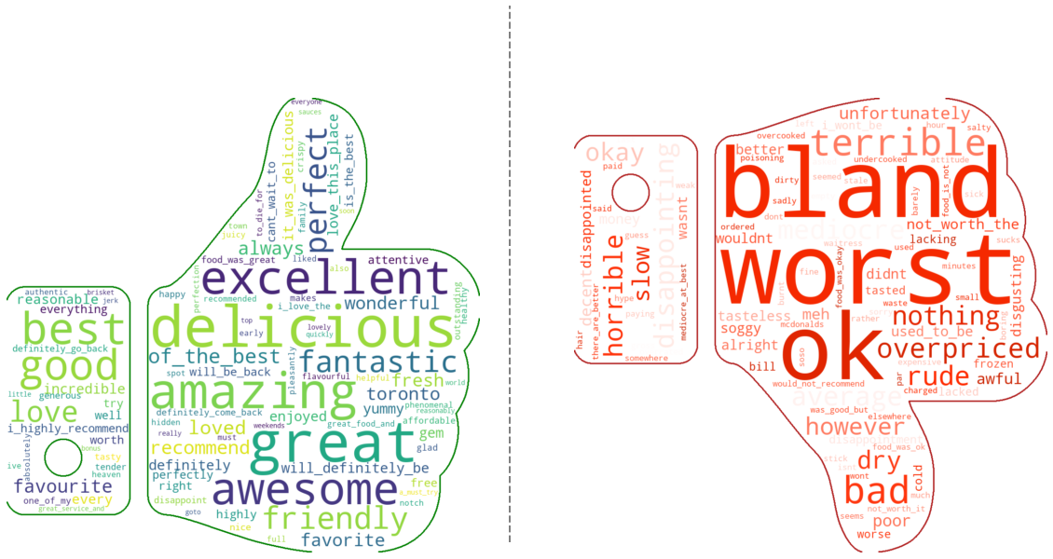
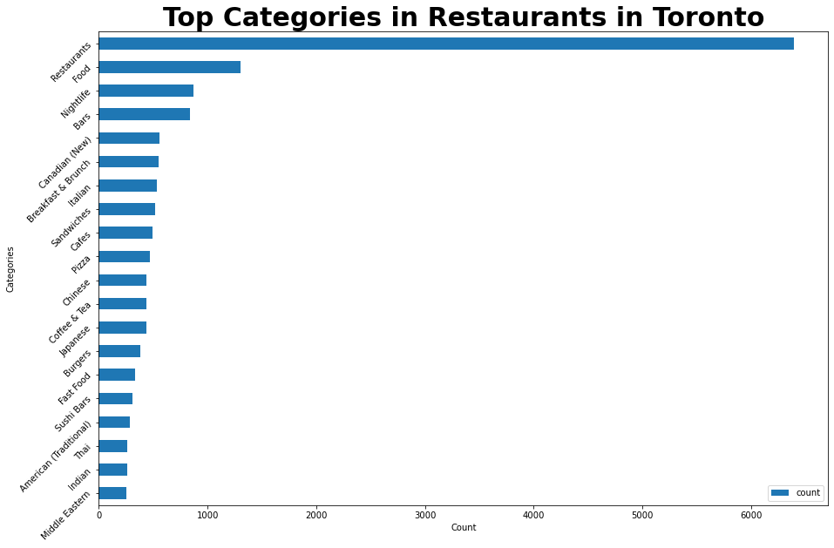
Sentiment Analysis
Sentiment Analysis helps Businesses understand the customer sentiment by assigning appropriate weights to the positive and negative words or sentiments most important to the customers.

Slide 5
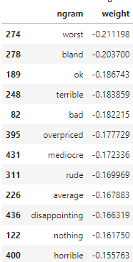
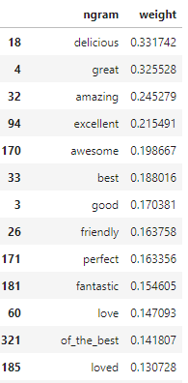
Sentiment Analysis
Filter on → Useful>1, stars > 0
Top 10 Negative word weights
Top 10 Positive word weights
SVM with SGD - Unigrams
Train-Test split: 80% : 20%
Model Performance:
F1 score: 0.8781
Area under ROC: 0.8687
Area under PR: 0.8662

Slide 6
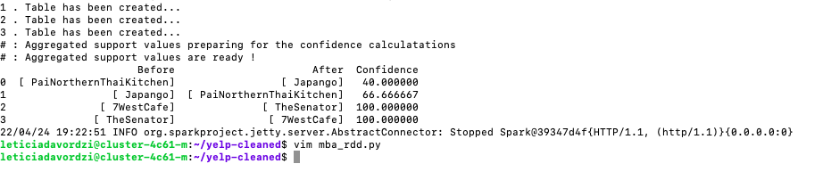
Market Basket Analysis with RDDs
The goal of Market Basket Analysis is discovering which groups of products tend to be purchased together.
Market Basket Analysis looks at how many times a specific grouping has occurred - perfect chance to make use of RDD’s to implement the method.
Market Basket Analysis and word frequency
Pairs using loops
A before B vs. B before A
Confidence values – how likely a customer is to buy B after buying A

Slide 7
Alternating Least Squares (ALS)
Collaborative Filtering is widely adopted in recommender systems.
If A agrees with B on some issues, A is likely to share B’s opinions on other issues.
ALS algorithm is a block relaxation algorithm applied to a least squares loss function.
ALS parameters:
rank: the number of latent factors in the model (defaults to 10).
maxIter: the maximum number of iterations to run (defaults to 10).
regParam: specifies the regularization parameter in ALS (defaults to 1.0).
Results:
Root-Mean-Square Error = 1.2551
r2 = -0.0983

Slide 8
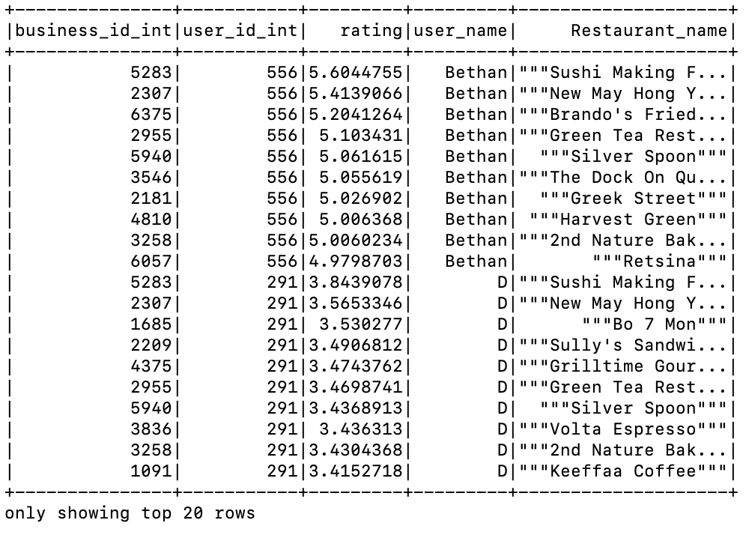
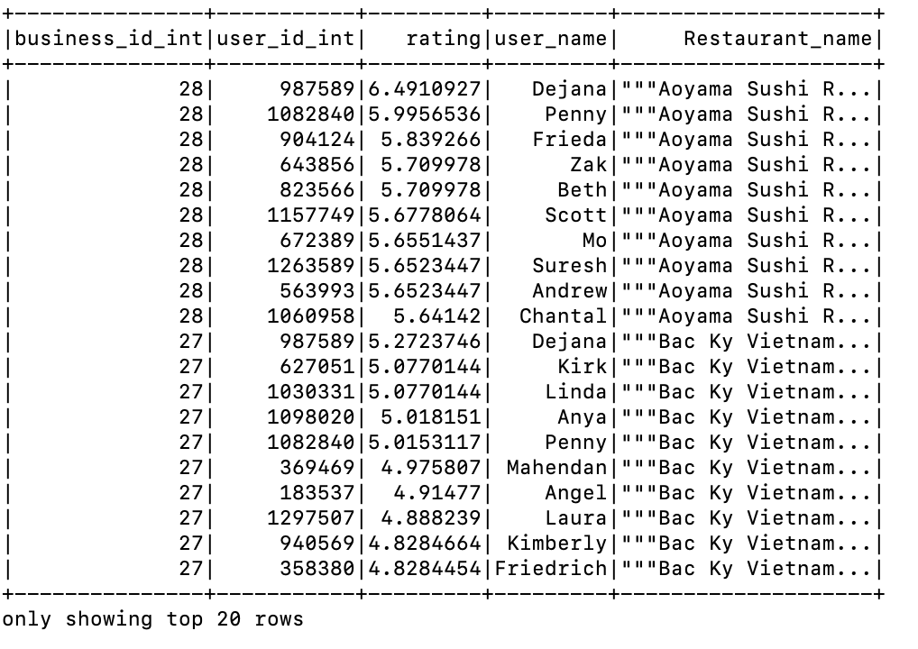

Visualize Recommendations
Recommending 10 restaurants to top 10 users top 10 user recommendations for top 10 restaurants
Tuning the ALS model with parameters maxIter = 10, regParams=[0.01, 0.3,0.8], ranks=[10,20] result:

Slide 9
Thank You!
Any questions?

